Slide 1
DAvao
9th phil bist
Colleges
brokenshire resort & convention center
uuniversities
August 10 – 12 ,2015
Theme: Excellent Library Services as measures of Outcomes - Based Education in the K+12 and Higher Education
network
Resource speakers
libcom

Slide 2
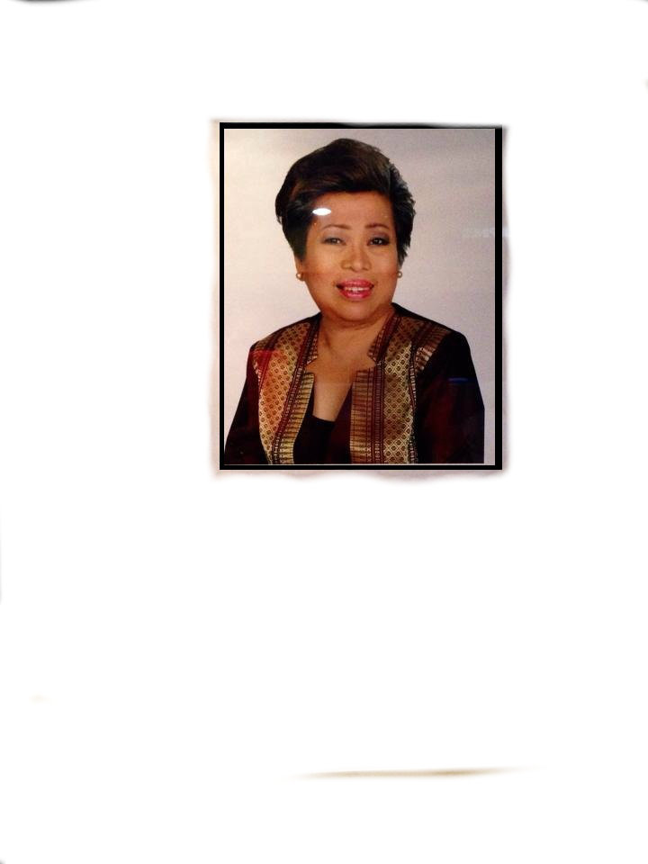
DR. MARILOU P. TADLIP
Vice Head, National Commission on
Library and Information Science
Topic : Senior High School Program Implications to Collection development

Slide 3
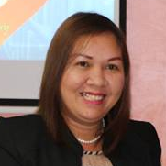
DR. ESTELA R. DEQUITO
Chief Librarian
Davao Doctors College
Topic : Impact of OBE in Libraries

Slide 4
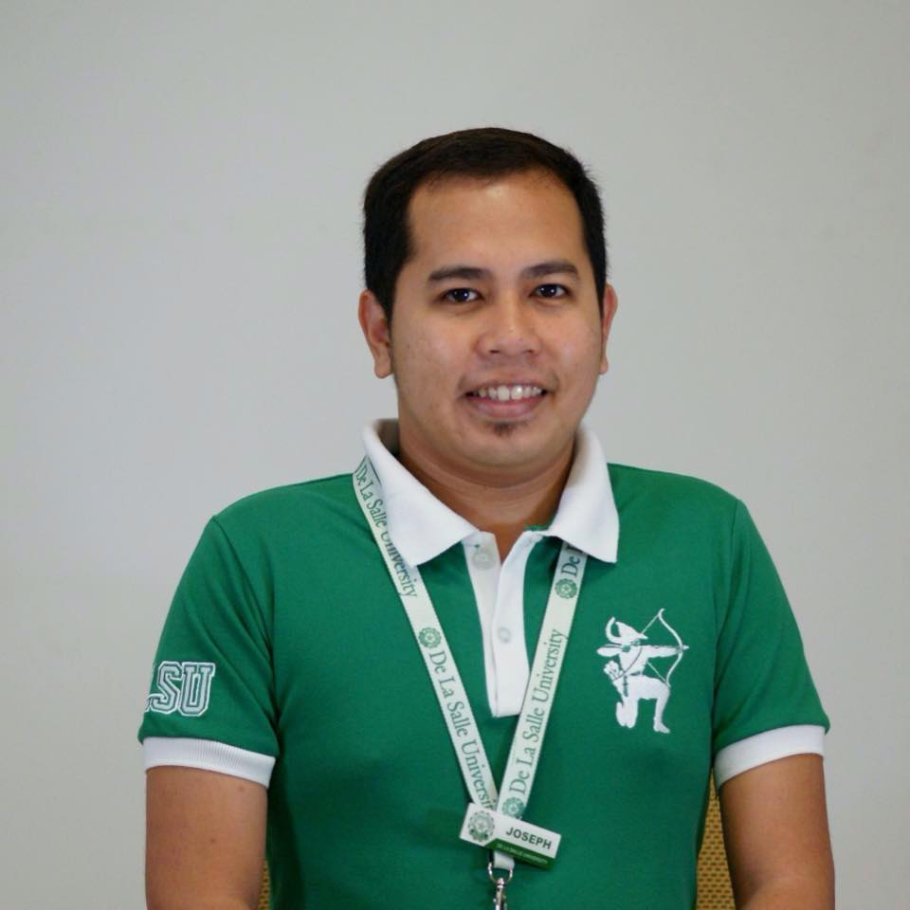
MR. JOSEPH M. YAP
IMS Coordinator
De La Salle University
Topic : Benefits of Mobile Computing in Libraries

Slide 5
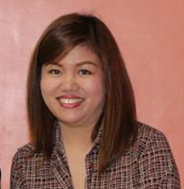
DR. MAYCHELLE M. NUGAS
University Librarian/University Planning Officer
University of Southeastern Philippines
Topic : Effective Planning Techniques for Library Managers: Aligning Plans, Resources, Services and Operations

Slide 6
PROF. ELVIRA B. LAPUZ
National President
Philippine Librarians Association Inc. (PLAI)
Topic : Libraries, Archives and Museums as the Third Space

Slide 7
PROF. ELVIRA B. LAPUZ
National President
Philippine Librarians Association Inc. (PLAI)

